Slide 1

CSCE883 Machine Learning
Lecture 3 Bayes+Evaluation
Jianjun Hu
Department of Computer Science & Engineering
University of South Carolina

Slide 2
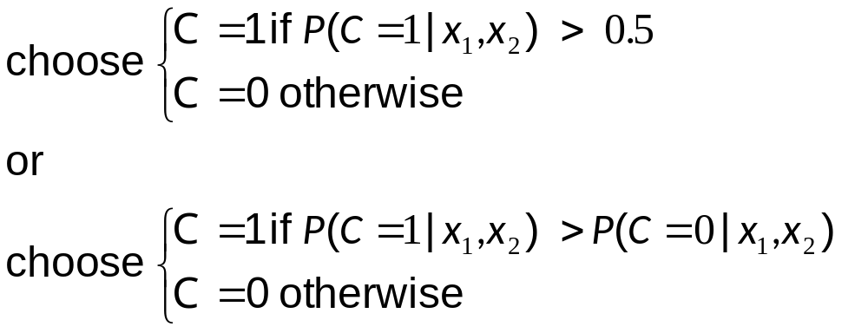
Classification
Credit scoring: Inputs are income and savings.
Output is low-risk vs high-risk
Input: x = [x₁,x₂]^{T} ,Output: C Î {0,1}
Prediction:

Slide 3
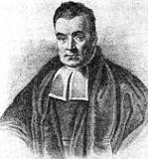
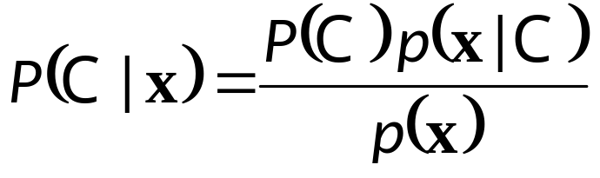
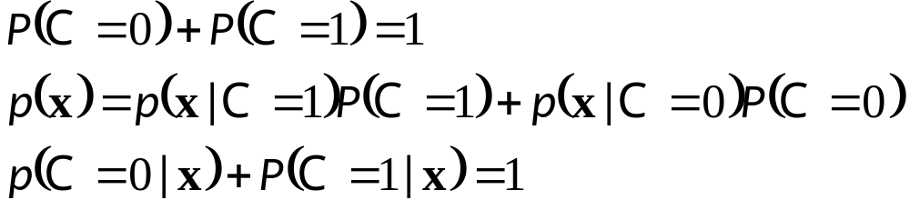
Bayes’ Rule
prior
likelihood
posterior
evidence

Slide 4
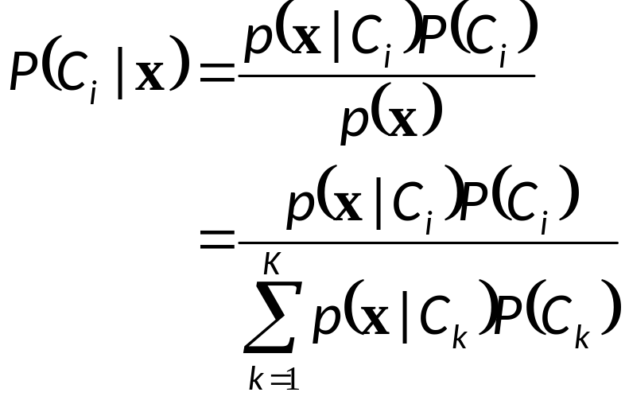
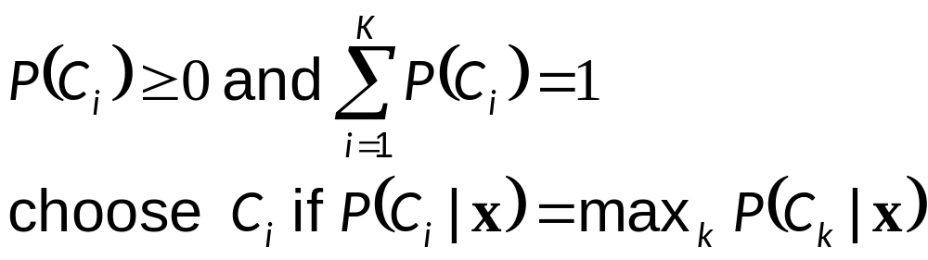
Bayes’ Rule: K>2 Classes

Slide 5
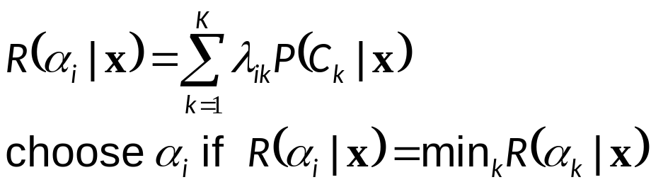
Losses and Risks
Actions: α_{i}
Loss of α_{i} when the state is C_{k} : λ_{ik}
Expected risk (Duda and Hart, 1973)

Slide 6
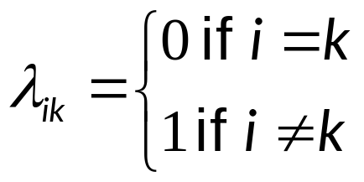
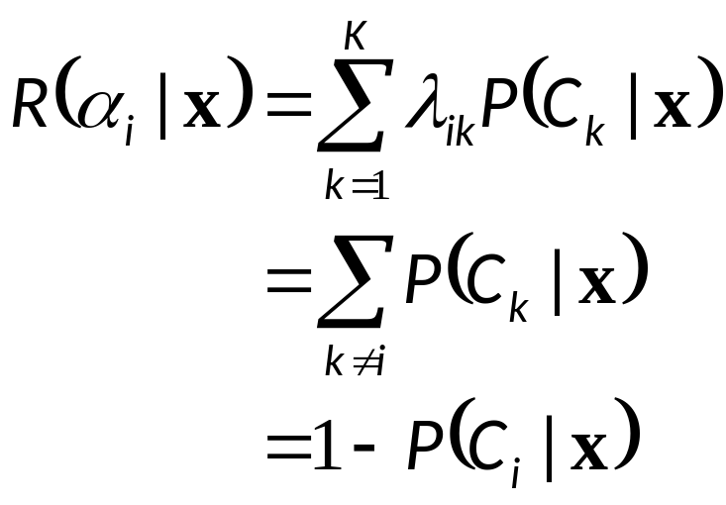
Losses and Risks: 0/1 Loss
For minimum risk, choose the most probable class

Slide 7
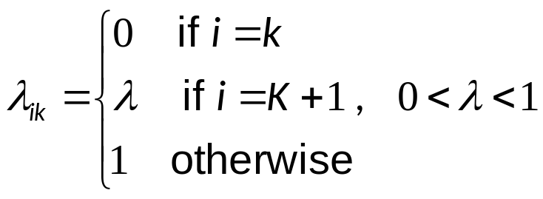
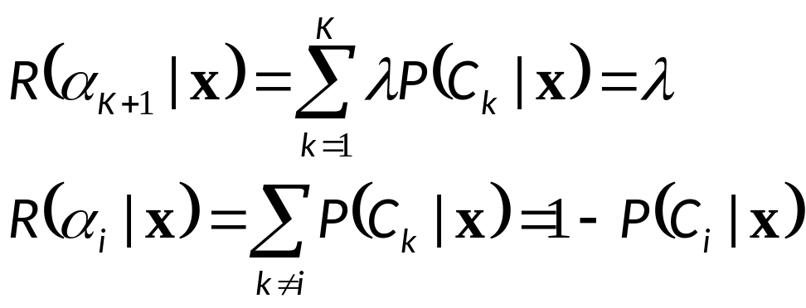
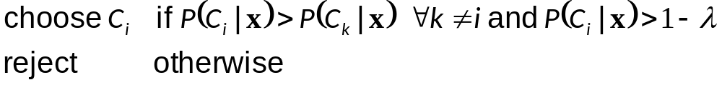
Losses and Risks: Reject

Slide 8
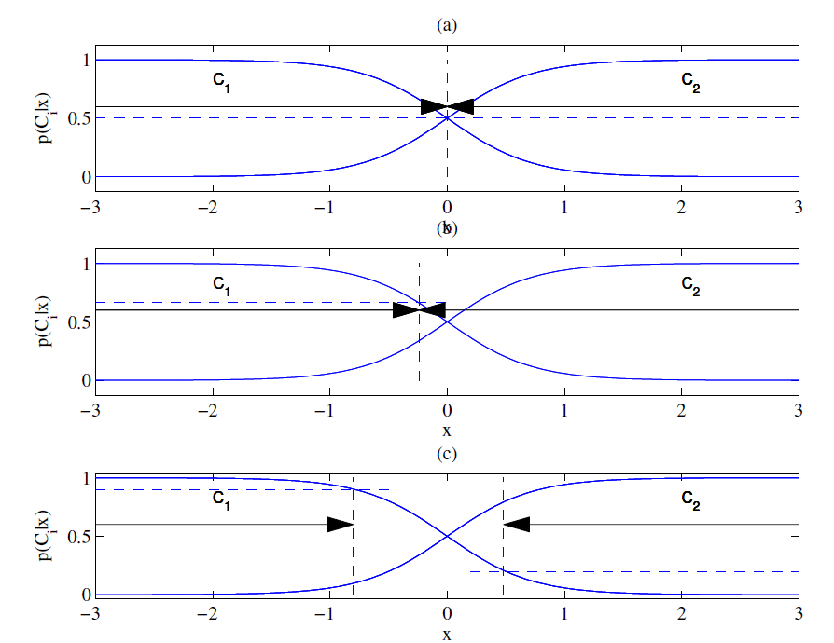
Different Losses and Reject
Equal losses
Unequal losses
With reject

Slide 9


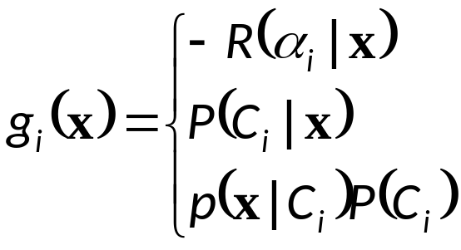
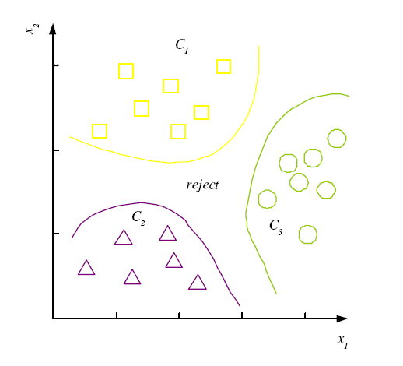

Discriminant Functions
K decision regions R₁,...,R_{K}

Slide 10
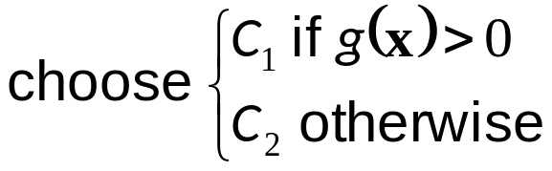
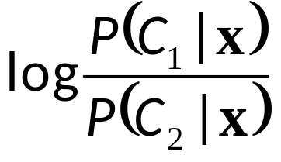
K=2 Classes
Dichotomizer (K=2) vs Polychotomizer (K>2)
g(x) = g₁(x) – g₂(x)
Log odds:

Slide 11
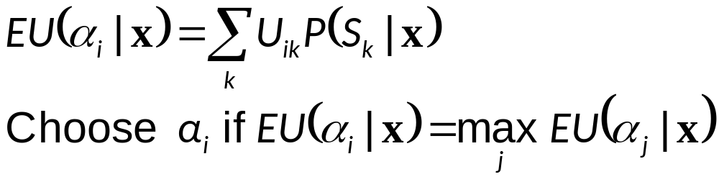
Utility Theory (in Reinforcement learning)
Prob of state k given exidence x: P (S_{k}|x)
Utility of α_{i} when state is k: U_{ik}
Expected utility:

Slide 12
Model Selection & Generalization
Learning is an ill-posed problem; data is not sufficient to find a unique solution
The need for inductive bias, assumptions about H
Generalization: How well a model performs on new data
Overfitting: H more complex than C or f
Underfitting: H less complex than C or f

Slide 13
Triple Trade-Off
There is a trade-off between three factors (Dietterich, 2003):
  Complexity of H, c (H),
  Training set size, N,
  Generalization error, E, on new data
As N, E↓
As c (H), first E↓ and then E

Slide 14
Evaluation of Classifiers

Slide 15
Evaluating classification algorithms
You have designed a new classifier.
You give it to me, and I try it on my image dataset

Slide 16
Evaluating classification algorithms
I tell you that it achieved 95% accuracy on my data.
Is your technique a success?

Slide 17
Types of errors
But suppose that
  The 95% is the correctly classified pixels
  Only 5% of the pixels are actually edges
  It misses all the edge pixels
How do we count the effect of different types of error?
class imbalance affects

Slide 18
Types of errors
Prediction
Edge Not edge
Ground Truth
Not Edge Edge
True Positive | False Negative
False Positive | True Negative

Slide 19
Two parts to each: whether you got it correct or not, and what you guessed. For example for a particular pixel, our guess might be labelled…
True Positive
Did we get it correct? True, we did get it correct.
What did we say? We said ‘positive’, i.e. edge.
or maybe it was labelled as one of the others, maybe…
False Negative
Did we get it correct? False, we did not get it correct.
What did we say? We said ‘negative, i.e. not edge.

Slide 20
Sensitivity and Specificity
Count up the total number of each label (TP, FP, TN, FN) over a large dataset. In ROC analysis, we use two statistics:
TP
Can be thought of as the likelihood of spotting a positive case when presented with one.
Or… the proportion of edges we find.
Sensitivity =
TP+FN
TN
Can be thought of as the likelihood of spotting a negative case when presented with one.
Or… the proportion of non-edges that we find
Specificity =
TN+FP

Slide 21
TP
TN
Sensitivity = = ?
Specificity = = ?
TP+FN
TN+FP
Prediction
1
0
60+30 = 90 cases in the dataset were class 1 (edge)
1
60
30
Ground Truth
0
80+20 = 100 cases in the dataset were class 0 (non-edge)
80
20
90+100 = 190 examples (pixels) in the data overall

Slide 22
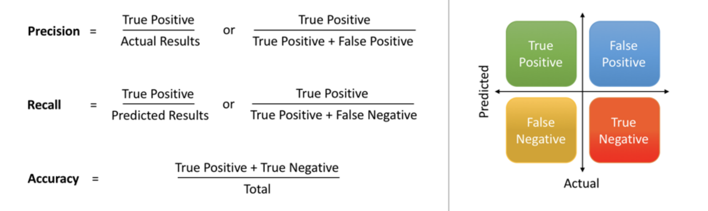
Precision and Recall &F1-score
Precision, recall and F1 use only three of the values in the confusion matrix: TP, FP, and FN

Slide 23
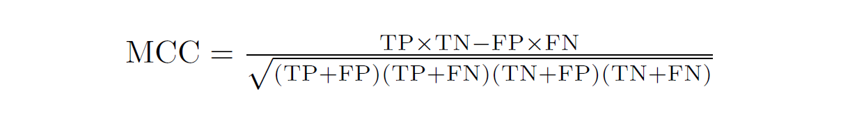
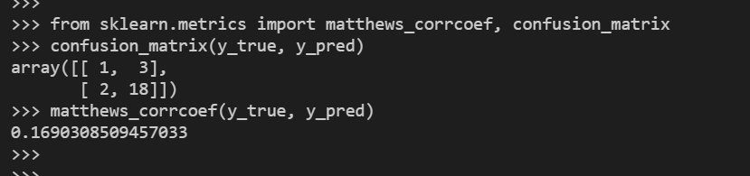
MCC
Matthews Correlation Coefficient is The Best Classification Metric You’ve Never Heard Of

Slide 24
The ROC space
1.0
This is edge detector A
This is edge detector B
Sensitivity
0.0
1.0
1 - Specificity
Note

Slide 25
The ROC Curve
Draw a ‘convex hull’ around many points:
Sensitivity
This point is not on the convex hull.
1 - Specificity

Slide 26
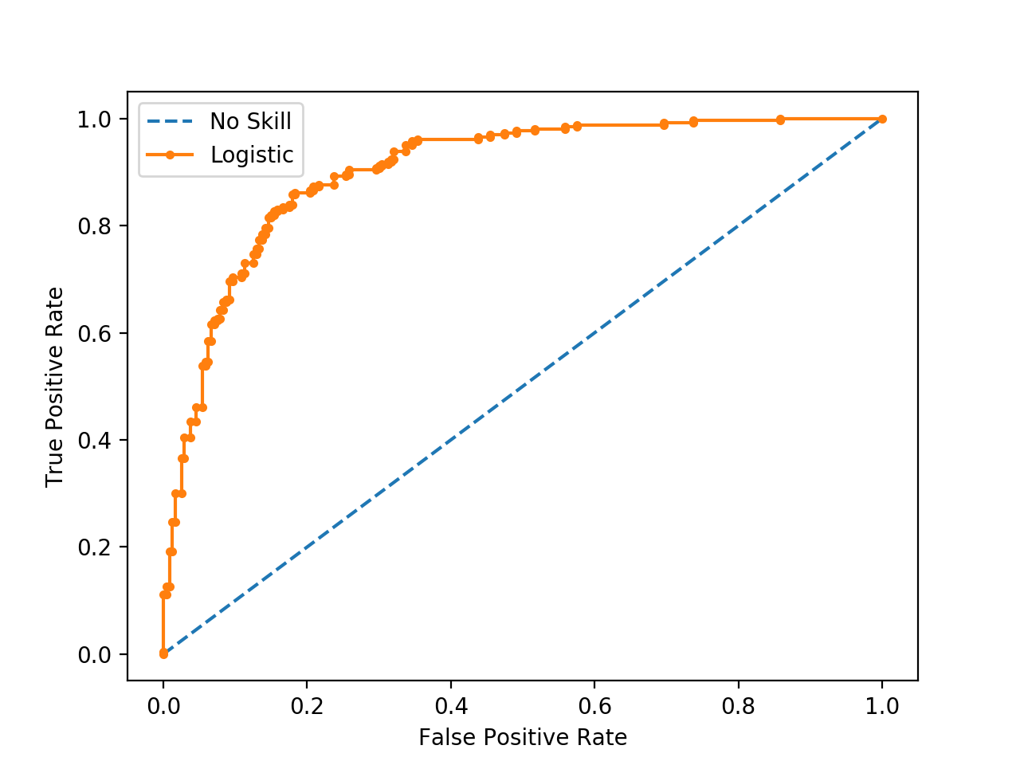
ROC curve. AUC
True Positive Rate = True Positives / (True Positives + False Negatives)
False Positive Rate = False Positives / (False Positives + True Negatives)

Slide 27
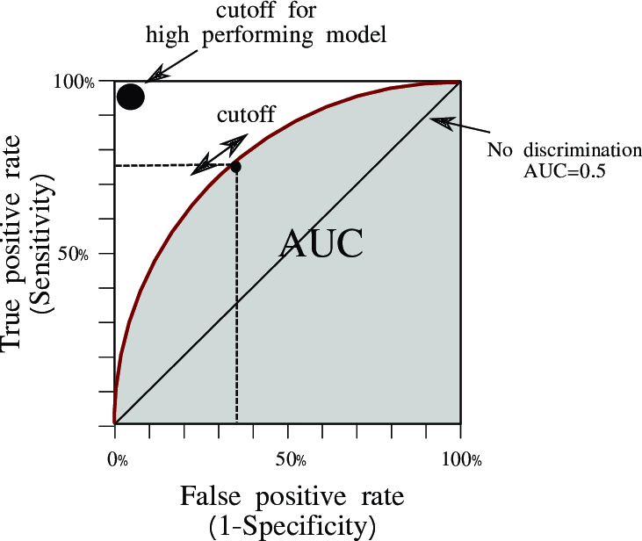

Slide 28
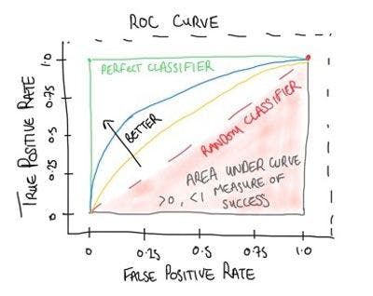

Slide 29
ROC Analysis
All the optimal detectors lie on the convex hull.
Which of these is best depends on the ratio of edges to non-edges, and the different cost of misclassification
Any detector on this side can lead to a better detector by flipping its output.
sensitivity
1 - specificity
Take-home point : You should always quote sensitivity and specificity for your algorithm, if possible plotting an ROC graph. Remember also though, any statistic you quote should be an average over a suitable range of tests for your algorithm.

Slide 30
Compute Area Under the Receiver Operating Characteristic Curve (ROC AUC) from prediction scores
sklearn.metrics.roc_auc_score(y_true, y_score, *, average='macro', sample_weight=None, max_fpr=None, multi_class='raise', labels=None
Note: this implementation can be used with binary, multiclass and multilabel classification, but some restrictions apply (see Parameters).

Slide 31
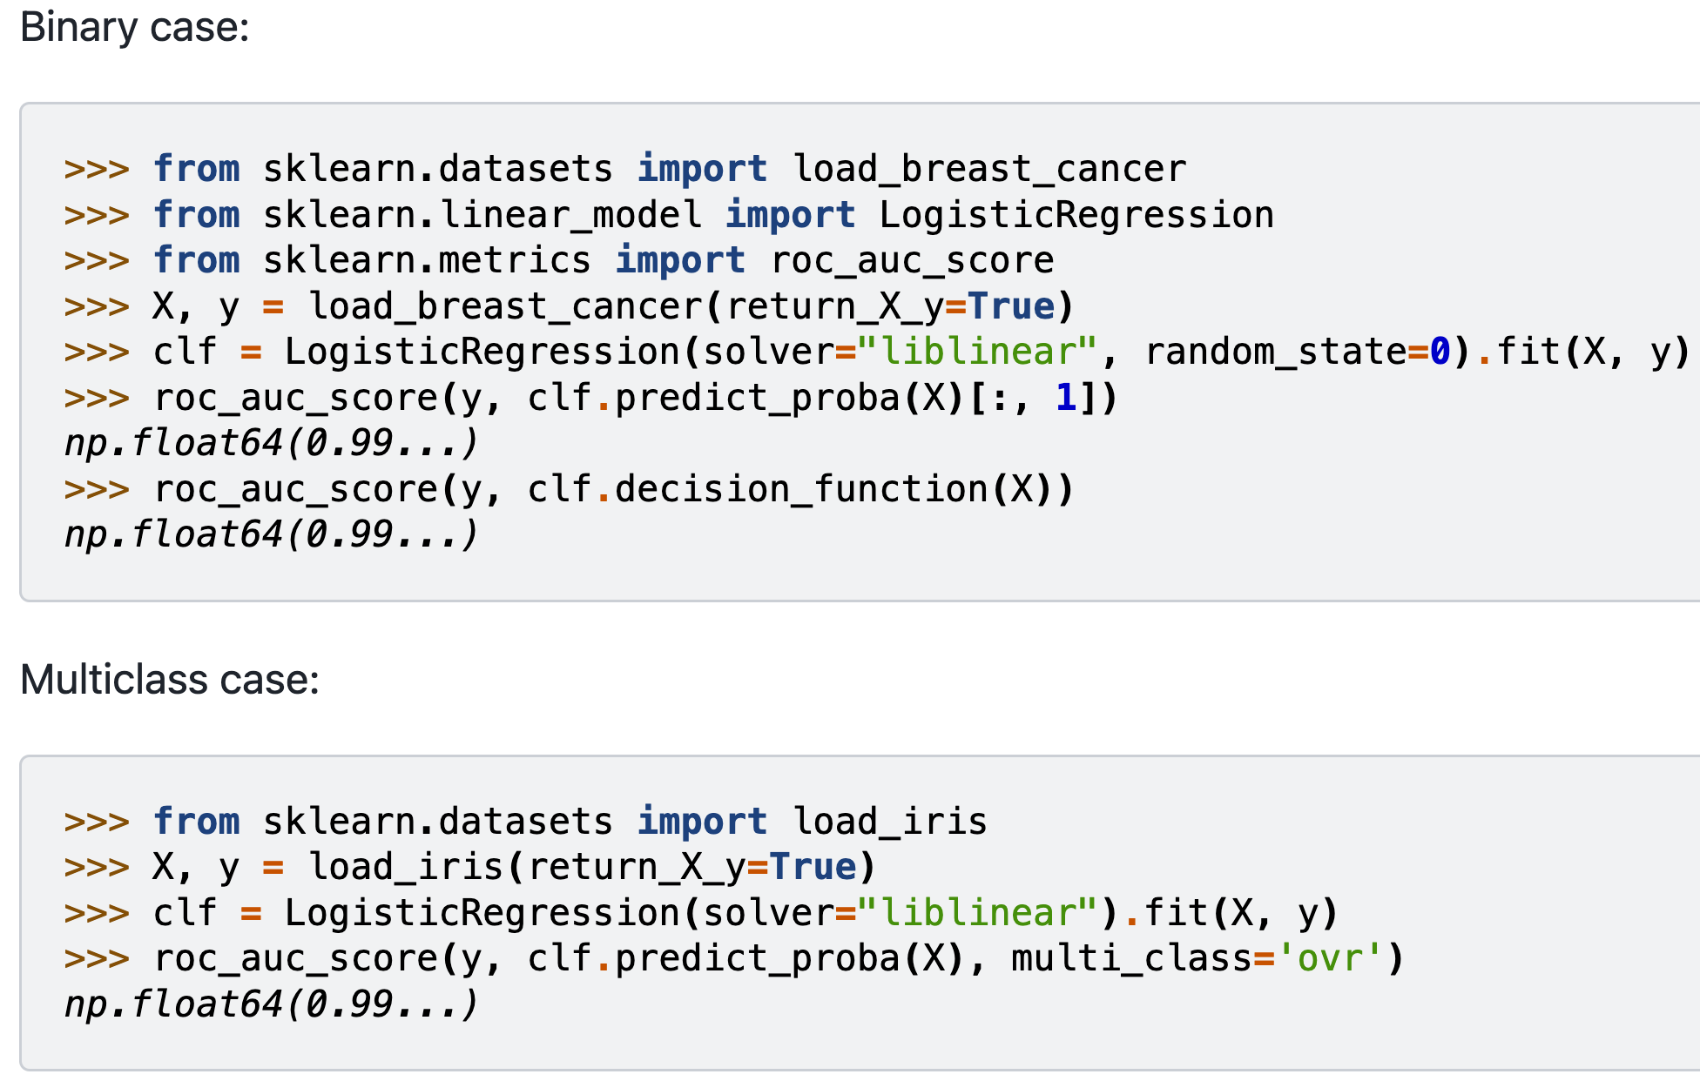

Slide 32
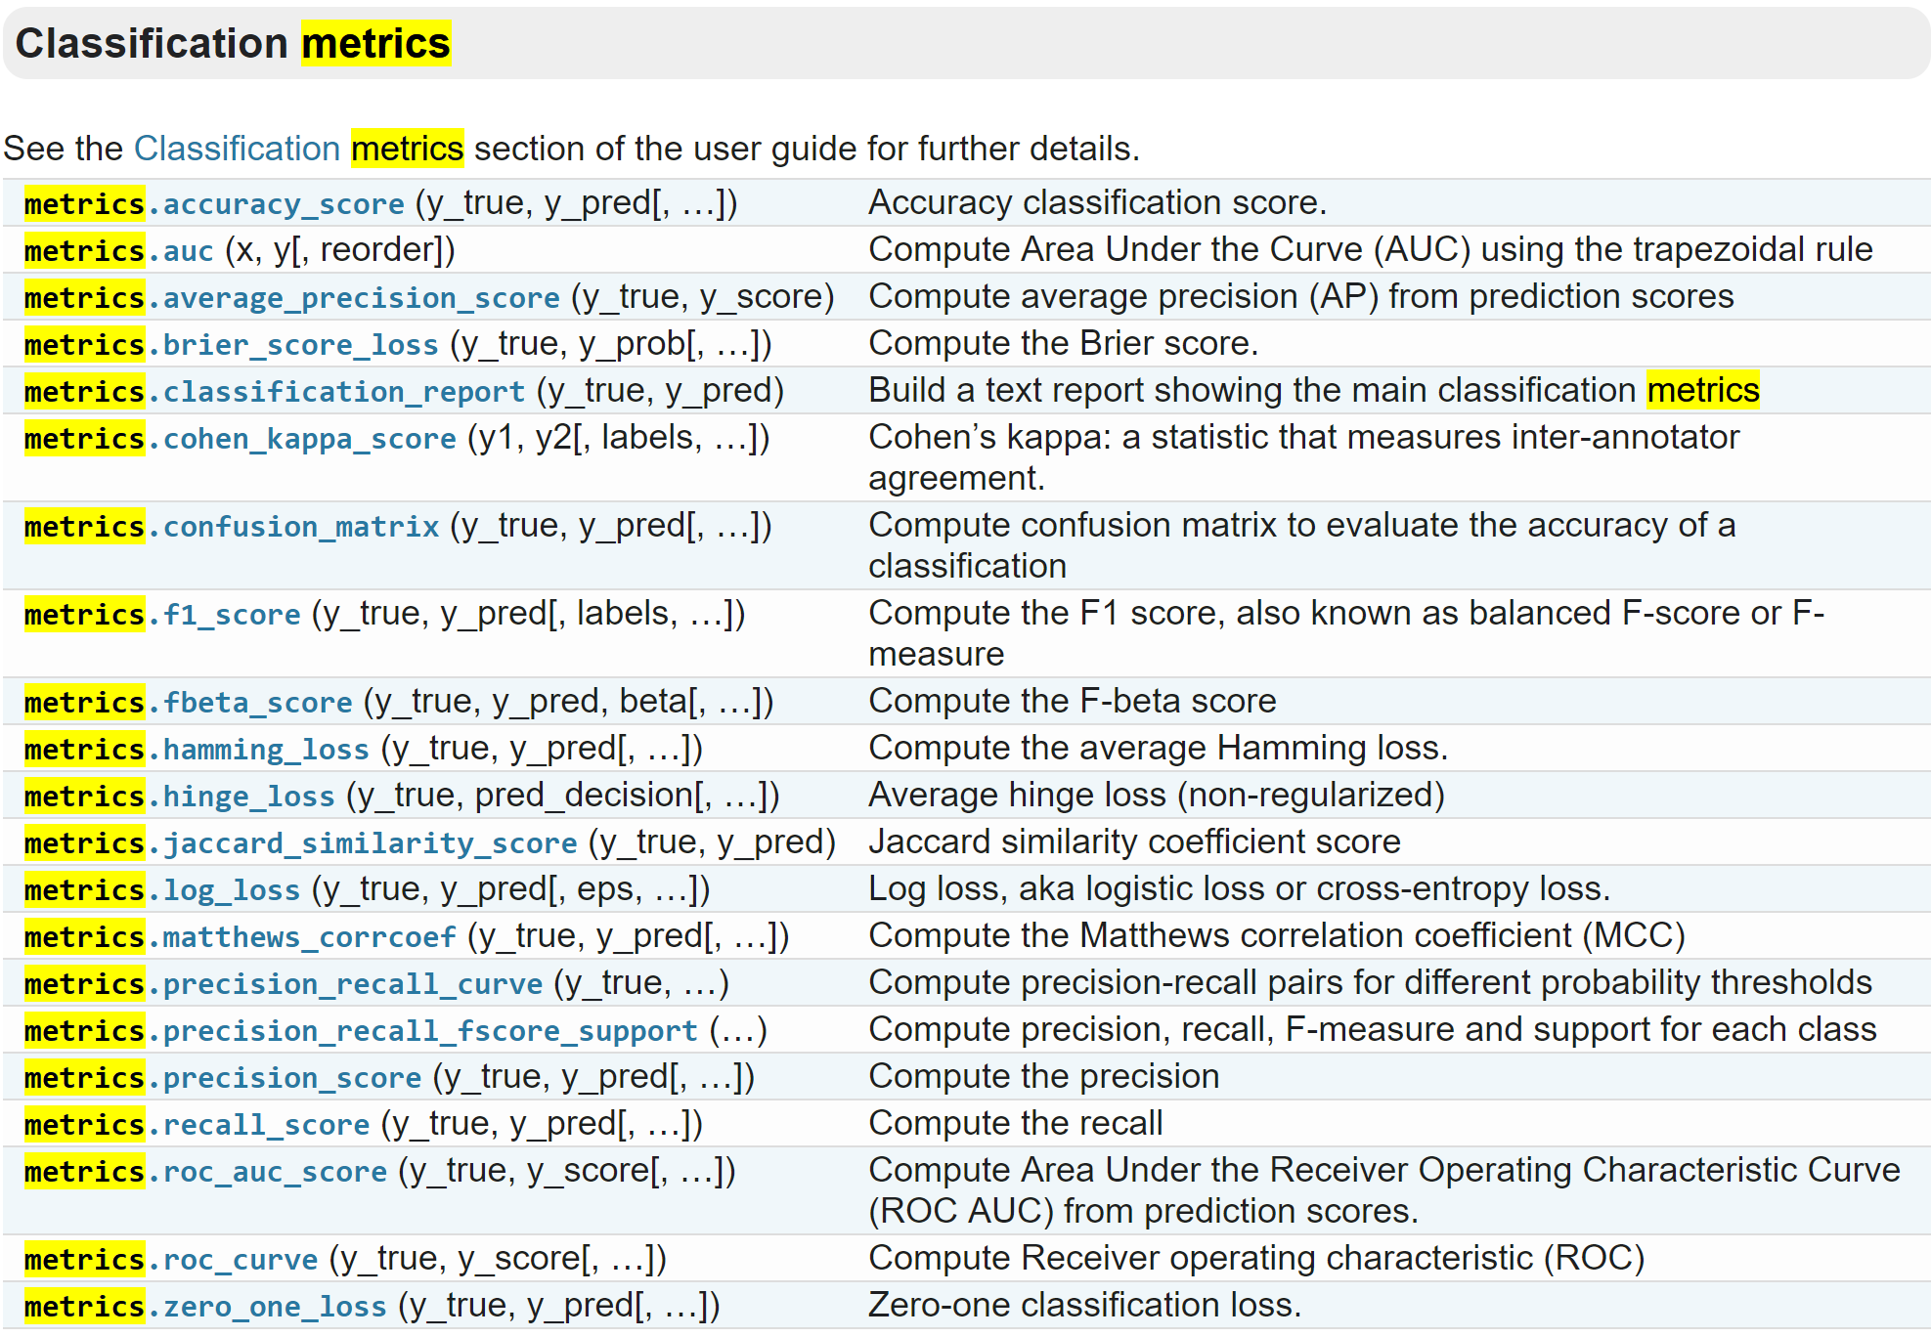
Classification Performances

Slide 33
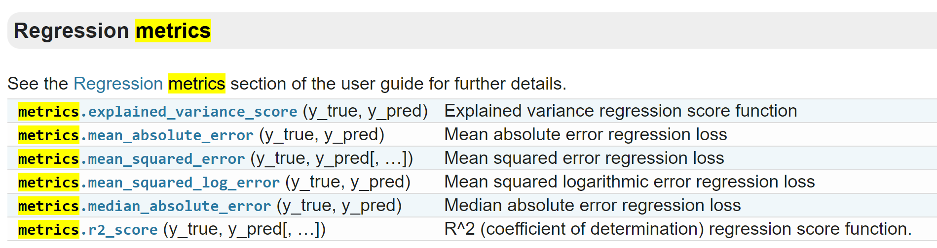
Regression Metrics

Slide 34
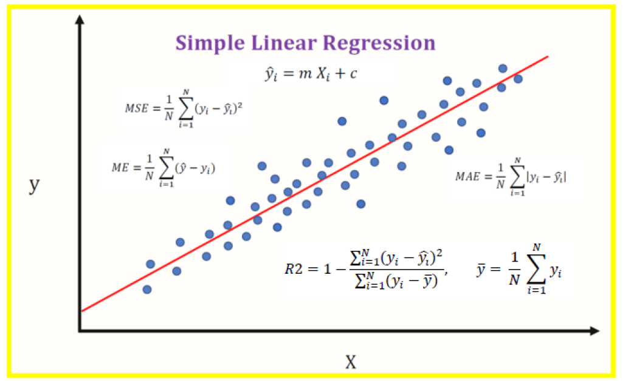

Slide 35
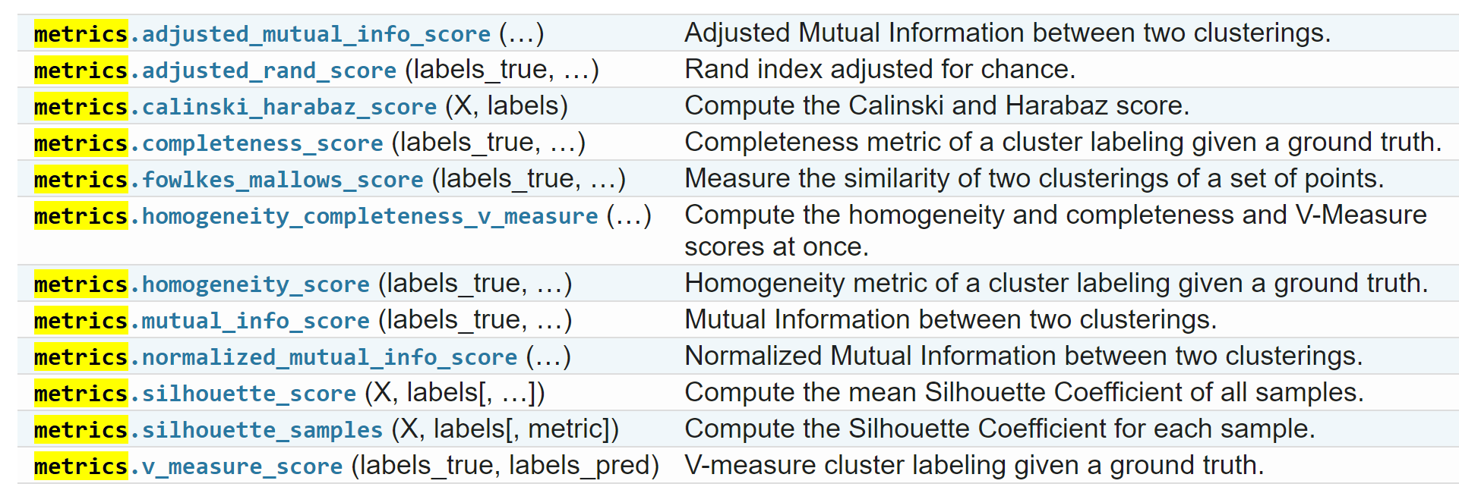
Clustering Metrics

Slide 36
Holdout estimation
(random splitting)
What to do if the amount of data is limited?
The holdout method reserves a certain amount for testing and uses the remainder for training
  ➔Usually: one third for testing, the rest for training

Slide 37
Holdout estimation
Problem: the samples might not be representative
  Example: class might be missing in the test data
Advanced version uses stratification
  Ensures that each class is represented with approximately equal proportions in both subsets

Slide 38
Repeated holdout method
Repeat process with different subsamples
➔ more reliable
  In each iteration, a certain proportion is randomly selected for training (possibly with stratificiation)
  The error rates on the different iterations are averaged to yield an overall error rate

Slide 39
Repeated holdout method
Still not optimum: the different test sets overlap
  Can we prevent overlapping?
  Of course!

Slide 40
Cross-validation
Cross-validation avoids overlapping test sets
  First step: split data into k subsets of equal size
  Second step: use each subset in turn for testing, the remainder for training
Called k-fold cross-validation

Slide 41

K-fold cross-validation

Slide 42
Cross-validation
Often the subsets are stratified before the cross-validation is performed
The error estimates are averaged to yield an overall error estimate

Slide 43
More on cross-validation
Standard method for evaluation: stratified ten-fold cross-validation
Why ten?
  Empirical evidence supports this as a good choice to get an accurate estimate
  There is also some theoretical evidence for this
Stratification reduces the estimate’s variance
Even better: repeated stratified cross-validation
  E.g. ten-fold cross-validation is repeated ten times and results are averaged (reduces the variance)

Slide 44
Leave-One-Out cross-validation
Leave-One-Out:
a particular form of cross-validation:
  Set number of folds to number of training instances
  I.e., for n training instances, build classifier n times
Makes best use of the data
Involves no random subsampling
Very computationally expensive
  (exception: NN)

Slide 45
Leave-One-Out-CV and stratification
Disadvantage of Leave-One-Out-CV: stratification is not possible
  It guarantees a non-stratified sample because there is only one instance in the test set!

Slide 46
Cross-Validation
To estimate generalization error, we need data unseen during training. We split the data as
  Training set (50%)
  Validation set (25%)
  Test (publication) set (25%)
Resampling when there is few data

Slide 47
Limitation of Hold-out and CV
The high redundancy or similarity among training samples leads to over-estimation of performance→Low performance on extrapolation

Slide 48
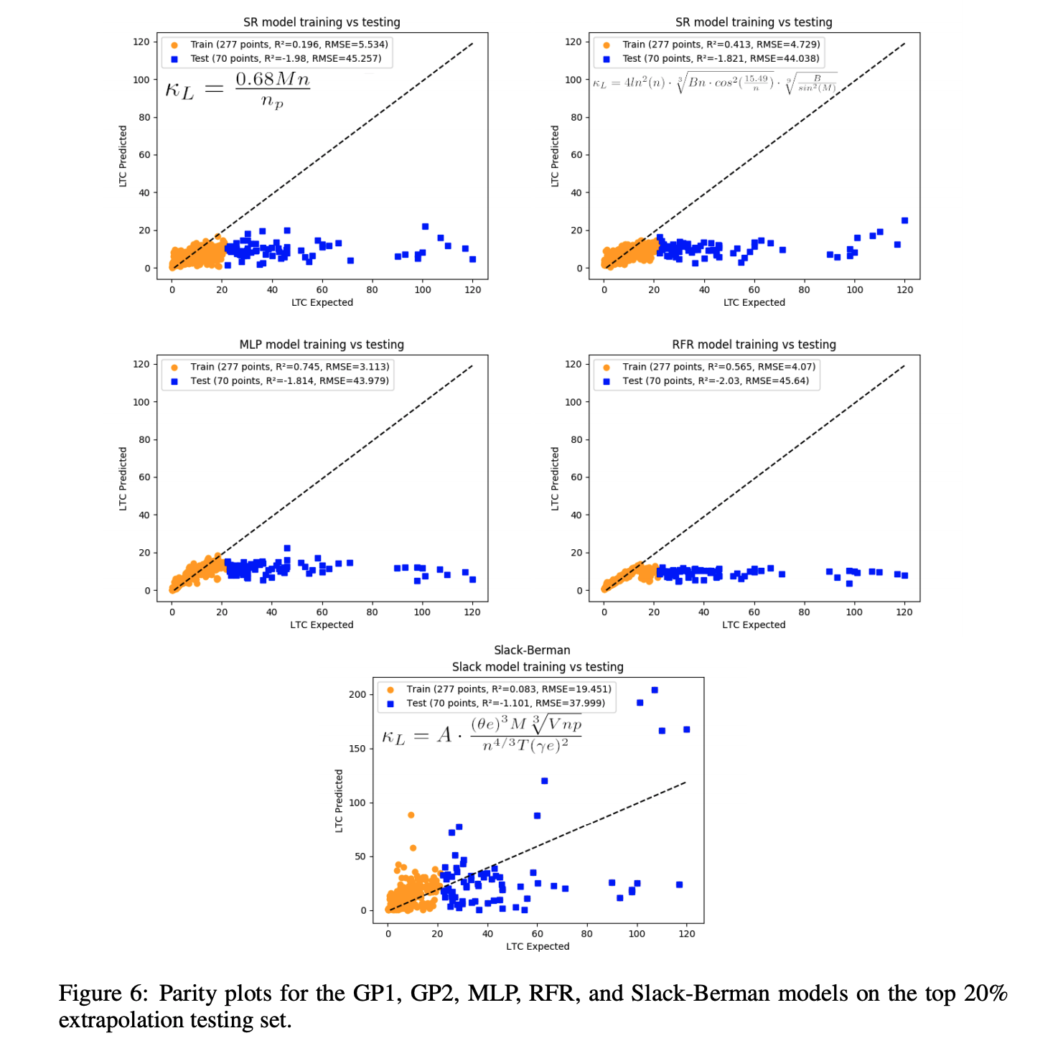
Low extrapolation performance

Slide 49
Acknowledgements
http://www.cmpe.boun.edu.tr/~ethem/i2ml3e
https://users.cs.fiu.edu/~taoli/class/CAP4770-F10/class08.ppt

